Slide 1


Break-Even Analysis
Name :- Harshil Kachhiya
Branch :- Information Technology
Sub :- EEM
En No. :- 160410116044
Sem :- 3

Slide 2
INTRODUCTION
A breakeven analysis is used to determine how much sales volume your business needs to start making a profit.
The breakeven analysis is especially useful when you're developing a pricing strategy, either as part of a marketing plan or a business plan.

Slide 3
BREAK EVEN CALCULATER
Fixed Cost:
The sum of all costs required to produce the first unit of a product. This amount does not vary as production increases or decreases, until new capital expenditures are needed.

Slide 4
Variable Unit Cost:
Costs that vary directly with the production of one additional unit.
Expected Unit Sales:
Number of units of the product projected to be sold over a specific period of time.
Unit Price:
The amount of money charged to the customer for each unit of a product or service.

Slide 5
Total Variable Cost:
The product of expected unit sales and variable unit cost.
(Expected Unit Sales * Variable Unit Cost )
Total Cost:
The sum of the fixed cost and total variable cost for any given level of production.
(Fixed Cost + Total Variable Cost )

Slide 6
Total Revenue:
The product of expected unit sales and unit price.
(Expected Unit Sales * Unit Price )
Profit (or Loss):
The monetary gain (or loss) resulting from revenues after subtracting all associated costs.
(Total Revenue - Total Costs)

Slide 7
BREAK EVEN POINT:
The point at which ferm get no profit and no loss.
Break Even Point (IN UNIT)= Fixed Cost /S. Price- Variable Unit Cost
Break Even Point (in Rs)=Fixed Cost/ S. Price-Variable unit Cost*Units

Slide 8
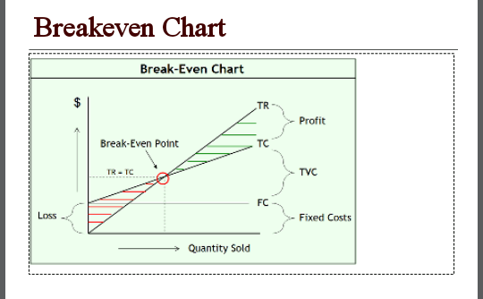

Slide 9
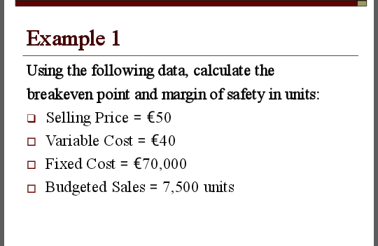

Slide 10
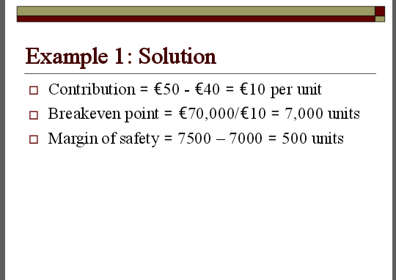

Slide 11
Case Study
Turkish Airlines
• Turkish Airlines was established on 20 May 1933 as State Airlines Administration
•Turkish Airline has been in existence for 81 years
•The slogan of Turkish Airline is Widen your World
•It has a Total number of 18,667 employees as at November 2013•The Airline’s headquartered is at the Turkish
Airlines General Management Building of Atatürk Airport Istanbul, Turkey
•Turkish Airline operates scheduled services to 41 domestic and 203 international airports in Europe, Asia, America and Africa
•It flights schedules covers 244 destinations
•Turkish Airline is the fourth-largest carrier in the world by number of destinations

Slide 12
THANK YOU

